Slide 1

AI Incident management platform
A Retrieval-Augmented Generation (RAG) Solution
Ai-Explorers

Slide 2
Challenges
Reduced Productivity due to repetitive tasks
Fragmented tools (ticketing, KBs, monitoring)
High mean time to resolution

Slide 3
RAG-Powered Incident Support System
What it does:
Unified console for incident resolution
AI chatbot for contextual support
Automated recommendations based on past incidents
Key features:
Supports solution with varying actions such as
script trigger,
workflows
escalation mail trigger

Slide 4
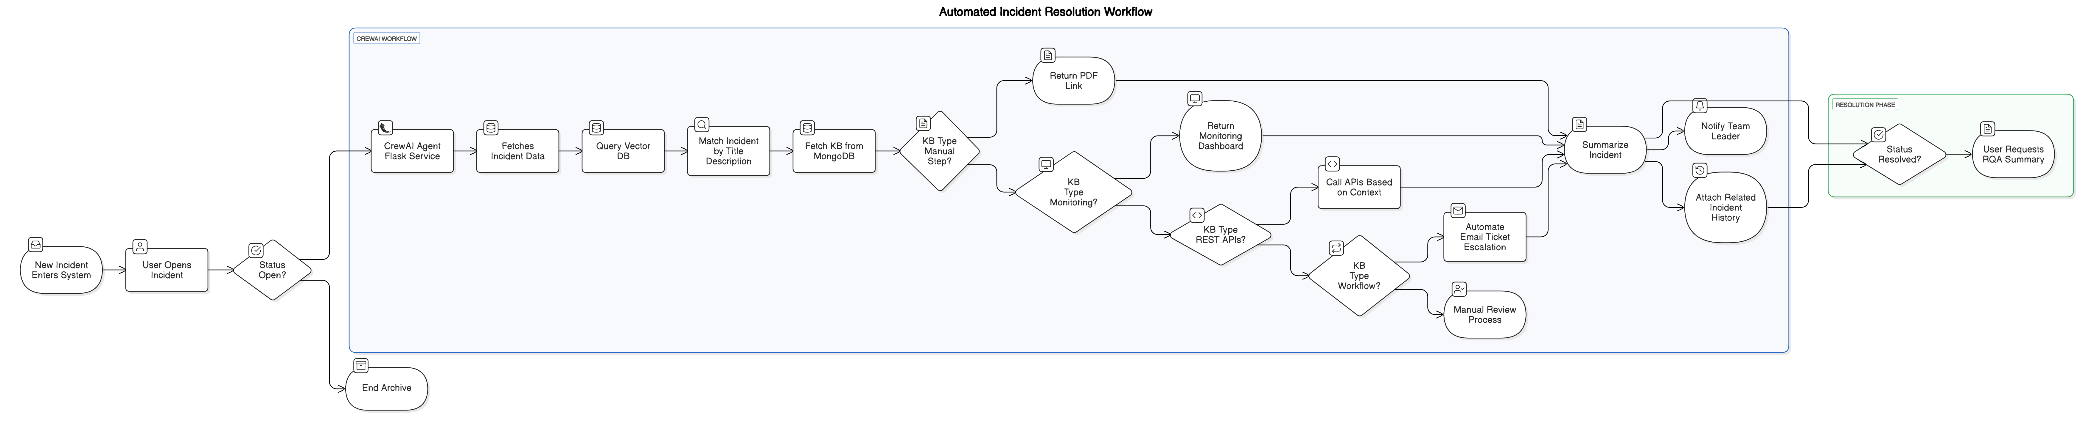
Incident Journey
Yes
Yes
No
Yes

Slide 5
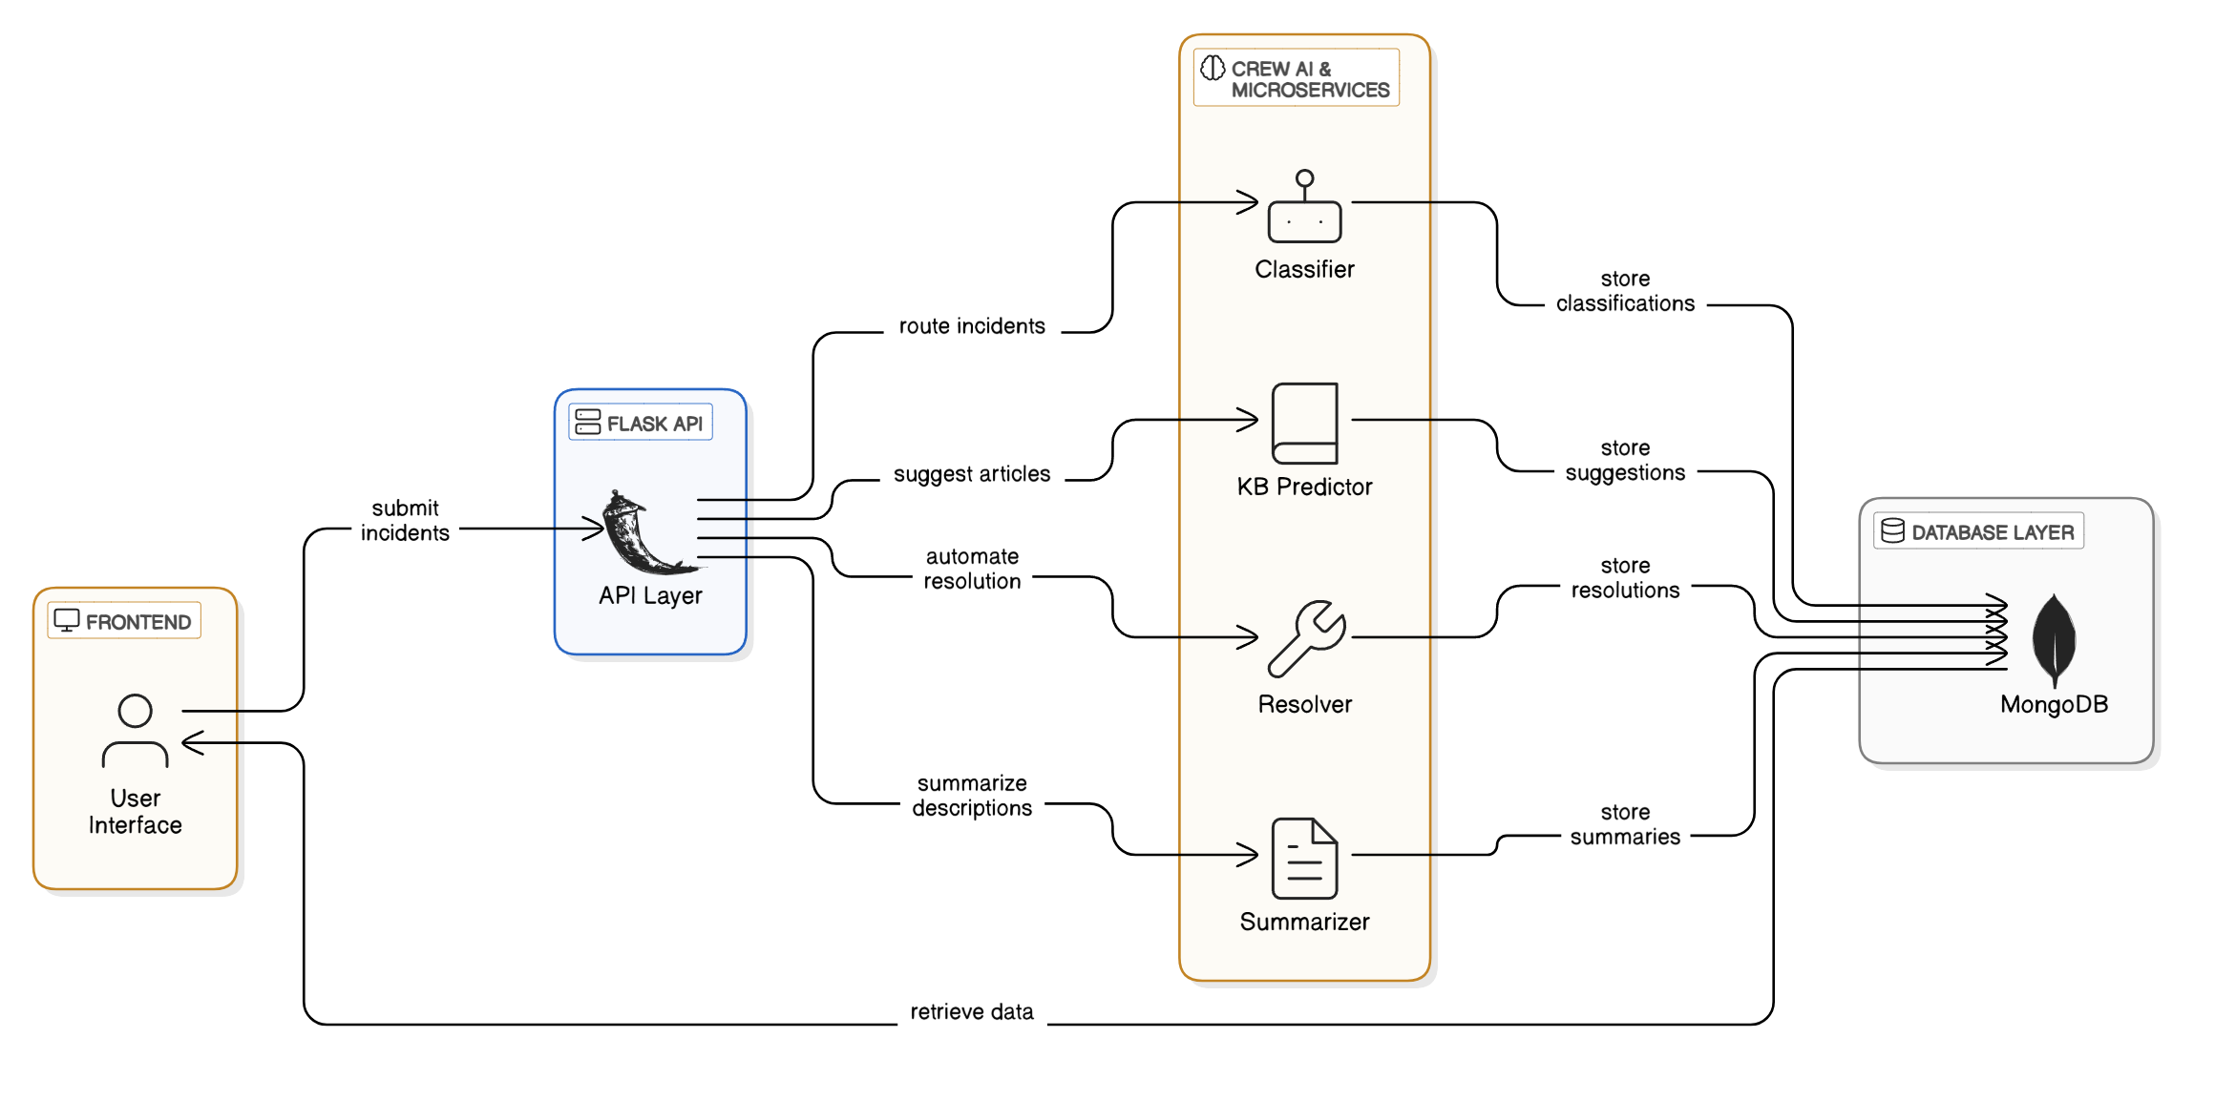
Architecture

Slide 6


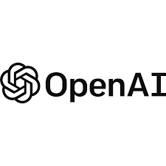


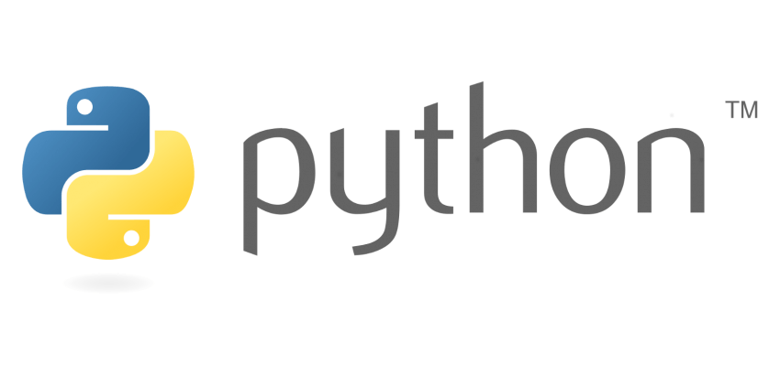


Tech stack
Vector DB:
MongoDB:
AI Layer:
Microservices:
Frontend:

Slide 7
DEMO
Open a sample incident
Fetches data dynamically
Show metrics
Show KB article
Automated Workflow
Fetch telemetry
Invokes Jenkins script
Send mail
Chat
Ask about any incident
Retains context
Summarizes incident

Slide 8
DEMO (Contd..)
Open a sample incident
Fetches data dynamically
Show metrics
Show KB article
Automated Workflow
Fetch telemetry
Invokes Jenkins script
Send mail
Chat
Ask about any incident
Retains context
Summarizes incident

Slide 9
DEMO (Contd..)
Open a sample incident
Fetches data dynamically
Show metrics
Show KB article
Automated Workflow
Fetch telemetry
Invokes Jenkins script
Send mail
Chat
Ask about any incident
Retains context
Summarizes incident

Slide 10




Scalability
AI
CrewAI can scale to any number of agents based on use cases
Vector DB
Used Pinecone vector DB for demo.
For Production, we propose Weaviate vector DB for its
Scalability
Hybrid word match vector embedding similarity search
Incident and Knowledgebase DB
MongoDB
Scalable, flexible data model
Supports KB structure that can help achieve extensible automation
Script Automation
Jenkins for triggering automation scripts

Slide 11
Challenges
Cost:
Good AI models are expensive over time. Calls can incur higher costs
Cost benefit analysis of LLMs to be done
Better models to be used for highly sensitive tasks and to be used judiciously
Risk:
If agent goals are not articulated properly, may lead to unintended results from the chain
Complete automation with out human intervention for critical incidents may lead to oversight
Regulatory:
Agents should be used only in scenarios which are approved as per regulations
API Support:
For activities related to monitoring or automated workflows/actions, in-house or third-party APIs may not be available readily

Slide 12

Q &A

